Slide 1
Calculus Refresher
CS771: Introduction to Machine Learning
Purushottam Kar

Slide 2
Topics to be Covered
Calculus basics: extrema, saddle points, gradient, Hessian,
Dealing with non-differentiable functions
Convex sets and convex functions

Slide 3
Extrema
Forget constraints for now – we will take care of them later!
Since we always seek the “best” values of a function, usually we are looking for the maxima or the minima of a function
Global extrema: a point which achieves the best value of the function (max/min) among all the possible points
Local extrema: a point which achieves the best value of the function only in a small region surrounding that point
Most machine learning algorithms love to find the global extrema
E.g. we saw that CSVM wanted to find the model with max margin
Sometimes it is difficult so we settle for local extrema (e.g. deepnets)
Global max
Local max
Global min
Local min

Slide 4







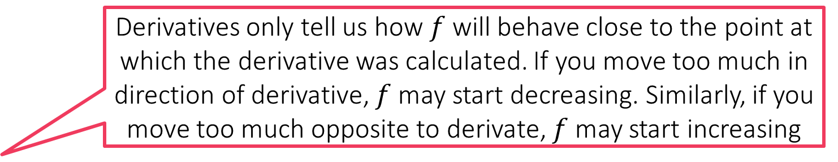
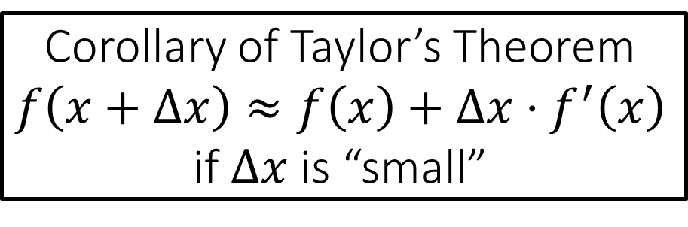

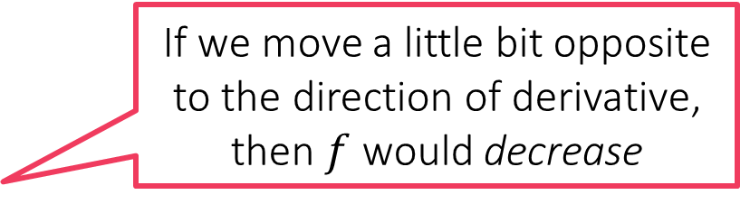

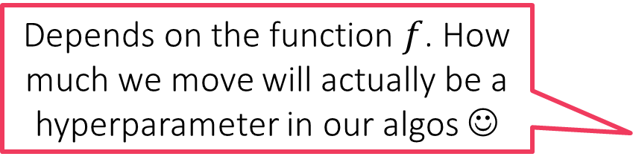
Derivatives
Derivatives only tell us how $f$ will behave close to the point at which the derivative was calculated. If you move too much in direction of derivative, $f$ may start decreasing. Similarly, if you move too much opposite to derivate, $f$ may start increasing
For a function $f:ℝ→ℝ$, the sign of its derivative at any point tells us whether we should move left or right on the number line to increase $f$.
If sign is positive, we should move right else left
Magnitude of the derivative tells us how steeply would $f$ increase if we moved a teeny tiny bit according to the derivative
Corollary of Taylor’s Theorem $$f\left(x+Δx\right)≈f\left(x\right)+Δx⋅f^{′}\left(x\right)$$ if $Δx$ is “small”
If we move a little bit opposite to the direction of derivative, then $f$ would decrease
Depends on the function $f$. How much we move will actually be a hyperparameter in our algos ☺
$$Δf$$
What if I moved in the opposite direction of the derivative?
$$Δx$$
$$Δx$$
How small is “small”?
Why do you keep saying “little bit”? What if I move a lot?
$$Δf$$

Slide 5
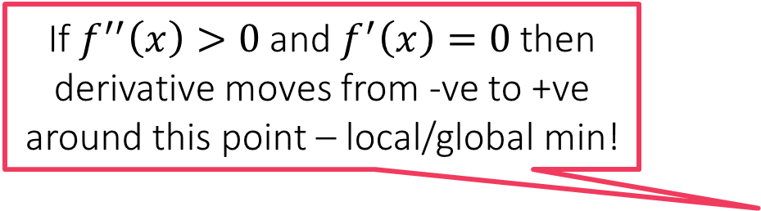
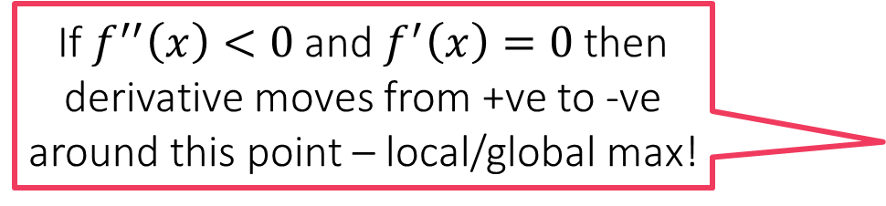
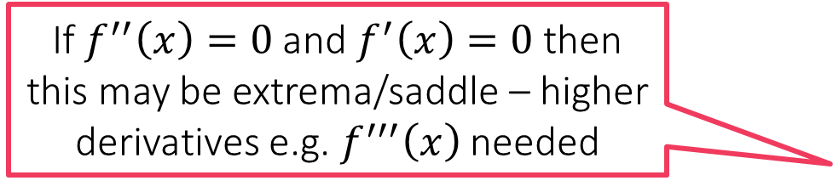
Stationary Points
If $f^{′′}\left(x\right)<0$ and $f^{′}\left(x\right)=0$ then derivative moves from +ve to -ve around this point – local/global max!
These are places where the derivative vanishes i.e. is 0
These can be local/global extrema or saddle points
The derivative being zero is its way of telling us that at that point, the function looks flat
Saddle points can be tedious in ML
We can find out if a stationary point is saddle or extrema using 2nd derivative
Just as sign of the derivative tells us if the function is increasing or decreasing if we move left a tiny bit, the 2nd derivative tells us if the derivative is increasing or decreasing if we move left a tiny bit
If $f^{′′}\left(x\right)=0$ and $f^{′}\left(x\right)=0$ then this may be extrema/saddle – higher derivatives e.g. $f^{′′′}\left(x\right)$ needed
If $f^{′′}\left(x\right)>0$ and $f^{′}\left(x\right)=0$ then derivative moves from -ve to +ve around this point – local/global min!
Yeah, not a big fan!

Slide 6
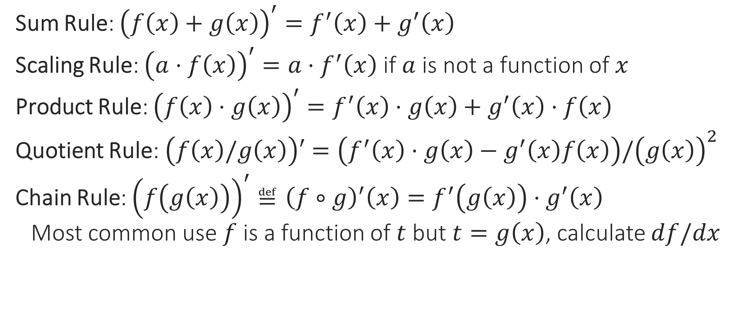
Rules of derivatives
Sum Rule: ${\left(f\left(x\right)+g\left(x\right)\right)}^{′}=f^{′}\left(x\right)+g^{′}\left(x\right)$
Scaling Rule: ${\left(a⋅f\left(x\right)\right)}^{′}=a⋅f^{′}\left(x\right)$ if $a$ is not a function of $x$
Product Rule: ${\left(f\left(x\right)⋅g\left(x\right)\right)}^{′}=f^{′}\left(x\right)⋅g\left(x\right)+g^{′}\left(x\right)⋅f\left(x\right)$
Quotient Rule: $\left(f\left(x\right)/g\left(x\right)\right)′=\left(f^{′}\left(x\right)⋅g\left(x\right)−g^{′}\left(x\right)f\left(x\right)\right)/{\left(g\left(x\right)\right)}^{2}$
Chain Rule: ${\left(f\left(g\left(x\right)\right)\right)}^{′}≝{\left(f∘g\right)}^{′}\left(x\right)=f^{′}\left(g\left(x\right)\right)⋅g^{′}\left(x\right)$
Most common use $f$ is a function of $t$ but $t=g\left(x\right)$, calculate $df/dx$

Slide 7

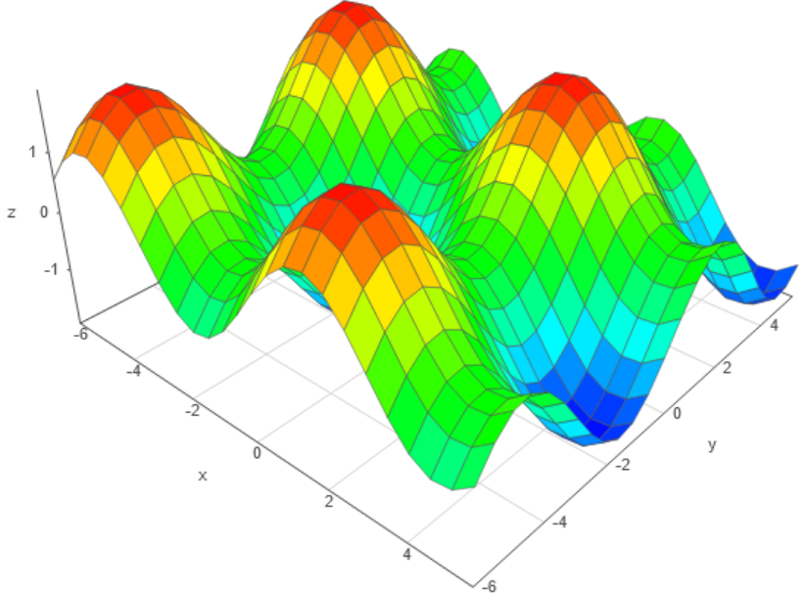
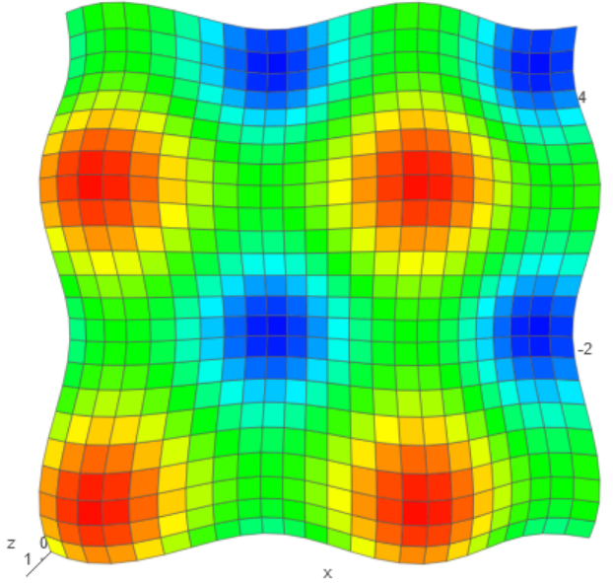


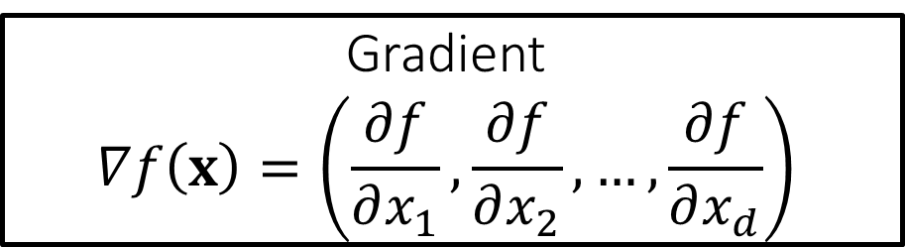



Multivariate Functions $f:ℝ^{d}→ℝ$
This looks just like the 1D case except that we are summing up contributions from all $d$ dimensions
Gradient $$∇f\left(x\right)=\left(\frac{∂f}{∂x_{1}},\frac{∂f}{∂x_{2}},…,\frac{∂f}{∂x_{d}}\right)$$
The gradient also has the distinction of offering the steepest ascent i.e. if we want maximum increase in function value, we must move a little bit along the gradient. Similarly, we must move a little bit in the direction opposite to gradient to get the maximum decrease in the function value, i.e. the gradient also offers us the steepest descent
Saddle
Taylor’s Theorem in higher dims If we move along vector $t=\left(t_{1},t_{2},…,t_{d}\right)$ then $f\left(x+t\right)≈f\left(x\right)+\sum_{i=1}^{d}{t_{i}⋅\frac{∂f\left(x\right)}{∂x_{i}}}=f\left(x\right)+t^{⊤}∇f\left(x\right)$ if $t$ is “small”
Local min
For multivariate functions with $d$-dim inputs, the gradient simply records how much the function would change if we move a little bit along each one of the $d$ axes!
Local max

Slide 8
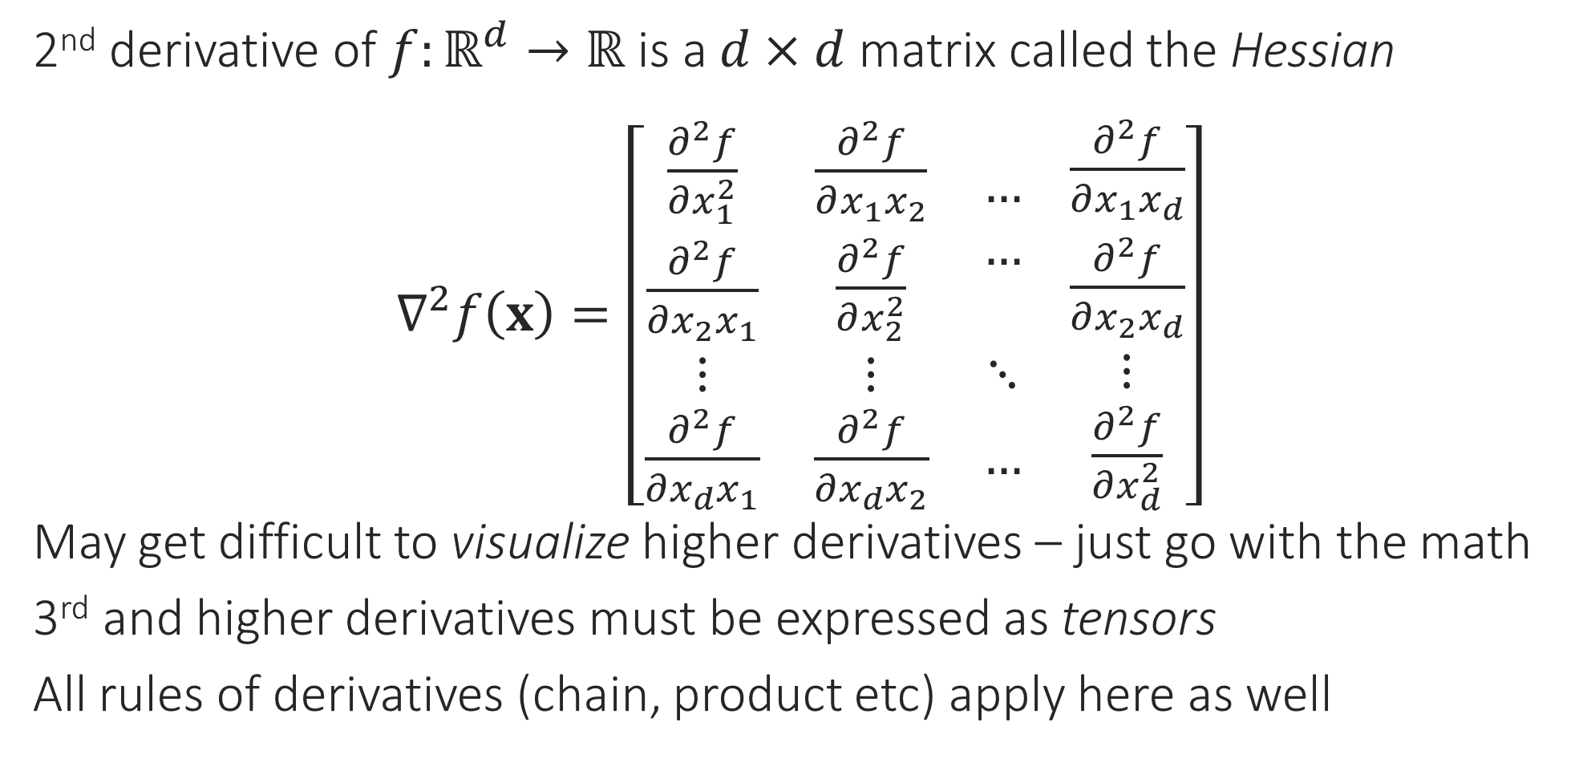
Higher derivatives in higher dimensions
2nd derivative of $f:ℝ^{d}→ℝ$ is a $d×d$ matrix called the Hessian
$∇^{2}f\left(x\right)=\left[\begin{matrix}\begin{aligned}\frac{∂^{2}f}{∂x_{1}^{2}} \\ \frac{∂^{2}f}{∂x_{2}x_{1}}\end{aligned} & \begin{aligned}\frac{∂^{2}f}{∂x_{1}x_{2}} \\ \frac{∂^{2}f}{∂x_{2}^{2}}\end{aligned} & \begin{aligned}… \\ …\end{aligned} \\ ⋮ & ⋮ & ⋱ \\ \frac{∂^{2}f}{∂x_{d}x_{1}} & \frac{∂^{2}f}{∂x_{d}x_{2}} & …\end{matrix} \begin{matrix}\frac{∂^{2}f}{∂x_{1}x_{d}} \\ \frac{∂^{2}f}{∂x_{2}x_{d}} \\ \begin{aligned}⋮ \\ \frac{∂^{2}f}{∂x_{d}^{2}}\end{aligned}\end{matrix}\right]$
May get difficult to visualize higher derivatives – just go with the math
3rd and higher derivatives must be expressed as tensors
All rules of derivatives (chain, product etc) apply here as well

Slide 9



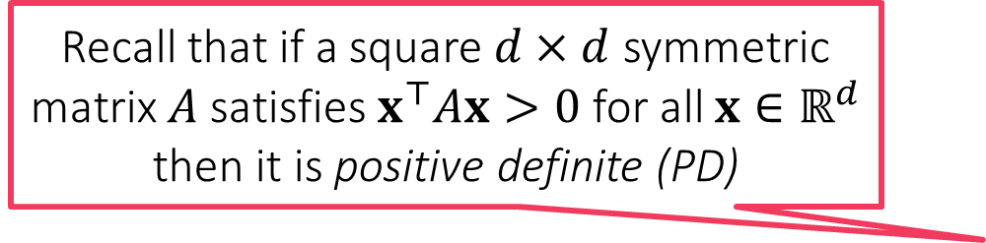

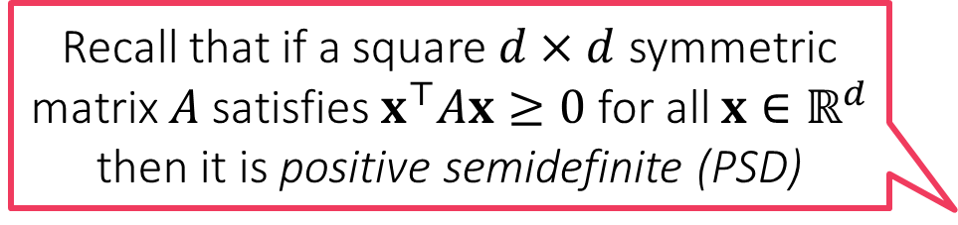
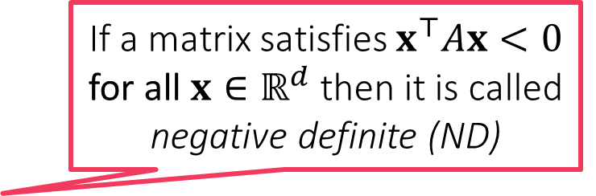
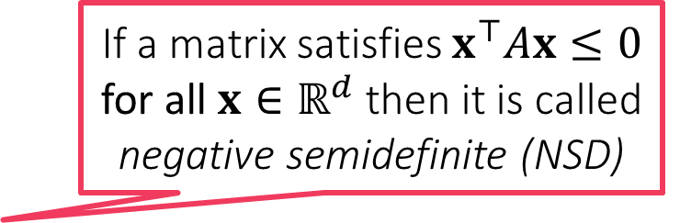
Stationary Points in $d$-dimensions
These are places where the gradient vanishes i.e. is a zero vector!
We can still find out if a stationary point is saddle or extrema using the 2nd derivative test just as in 1D
A bit more complicated to visualize, but the Hessian tells us how the surface of the function is curved at a point
If $∇f\left(x\right)=0$ and $∇^{2}f\left(x\right)$ is a PD matrix, then $x$ is a local/global min
If $∇f\left(x\right)=0$ and $∇^{2}f\left(x\right)$ is a ND matrix, then $x$ is a local/global max
If neither of these are true, then either $x$ is a saddle point or the test fails, need higher order derivatives to verify
Whether point is saddle or test has failed depends on eigenvalues of $∇f\left(x\right)$
We will learn about eigenvalues in a few weeks when we refresh linear algebra
If a matrix satisfies $x^{⊤}Ax<0$ for all $x∈ℝ^{d}$ then it is called negative definite (ND)
Recall that if a square $d×d$ symmetric matrix $A$ satisfies $x^{⊤}Ax>0$ for all $x∈ℝ^{d}$ then it is positive definite (PD)
If a matrix satisfies $x^{⊤}Ax≤0$ for all $x∈ℝ^{d}$ then it is called negative semidefinite (NSD)
Recall that if a square $d×d$ symmetric matrix $A$ satisfies $x^{⊤}Ax≥0$ for all $x∈ℝ^{d}$ then it is positive semidefinite (PSD)

Slide 10
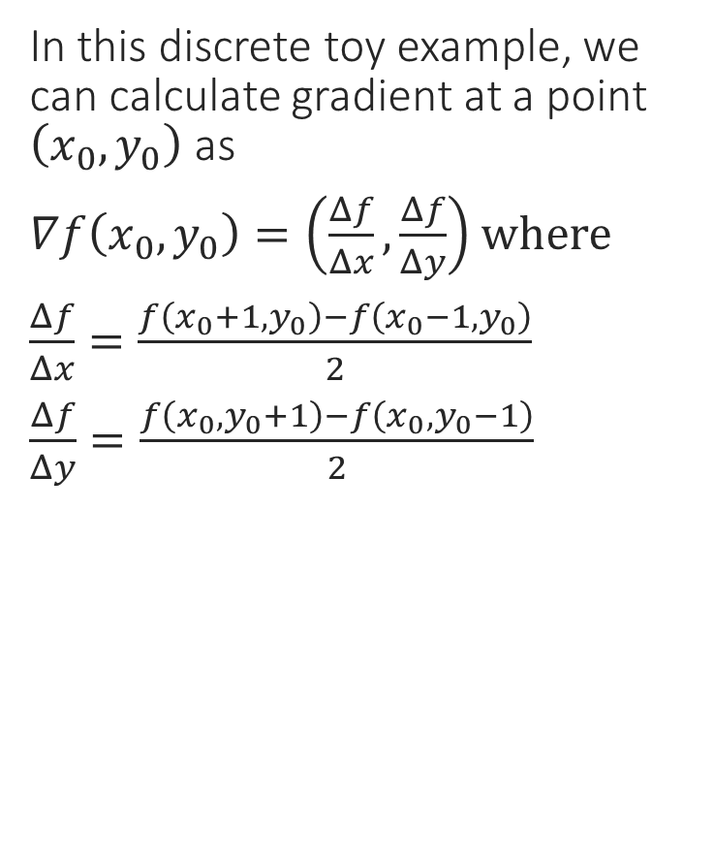
A Toy Example – Function Values
In this discrete toy example, we can calculate gradient at a point $\left(x_{0},y_{0}\right)$ as
$∇f\left(x_{0},y_{0}\right)=\left(\frac{Δf}{Δx},\frac{Δf}{Δy}\right)$ where
$\frac{Δf}{Δx}=\frac{f\left(x_{0}+1,y_{0}\right)−f\left(x_{0}−1,y_{0}\right)}{2}$
$\frac{Δf}{Δy}=\frac{f\left(x_{0},y_{0}+1\right)−f\left(x_{0},y_{0}−1\right)}{2}$
3 | 3 | 3 | 3 | 3 | 3 | 3 | 3 | 3
2 | 2 | 2 | 3 | 4 | 3 | 3 | 2 | 1
1 | 1 | 1 | 3 | 3 | 3 | 1 | 1 | 1
1 | 0 | 1 | 1 | 2 | 1 | 1 | 0 | 1
1 | 1 | 1 | 3 | 3 | 3 | 1 | 1 | 1
1 | 2 | 3 | 3 | 4 | 3 | 2 | 2 | 2
3 | 3 | 3 | 3 | 3 | 3 | 3 | 3 | 3
0 1 2 3 4 5 6
0 1 2 3 4 5 6 7 8

Slide 11
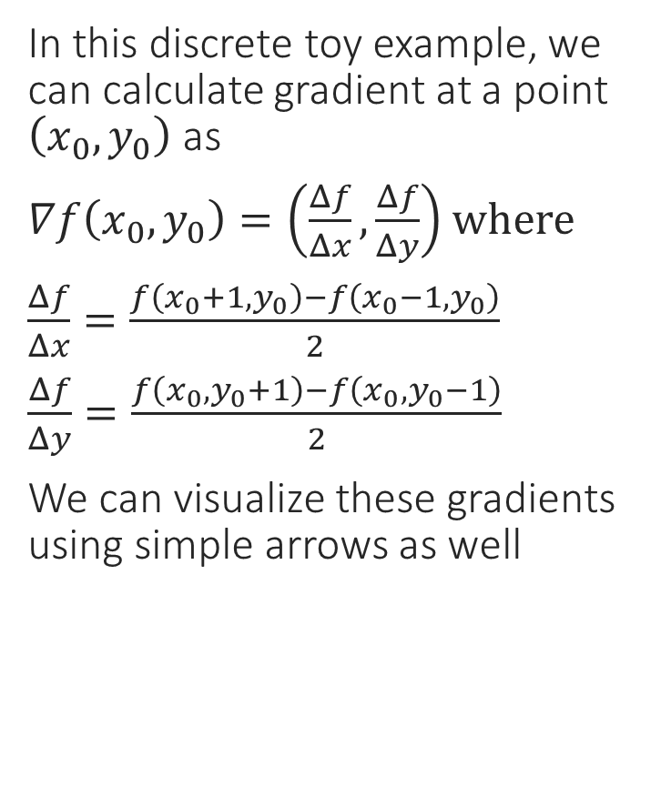
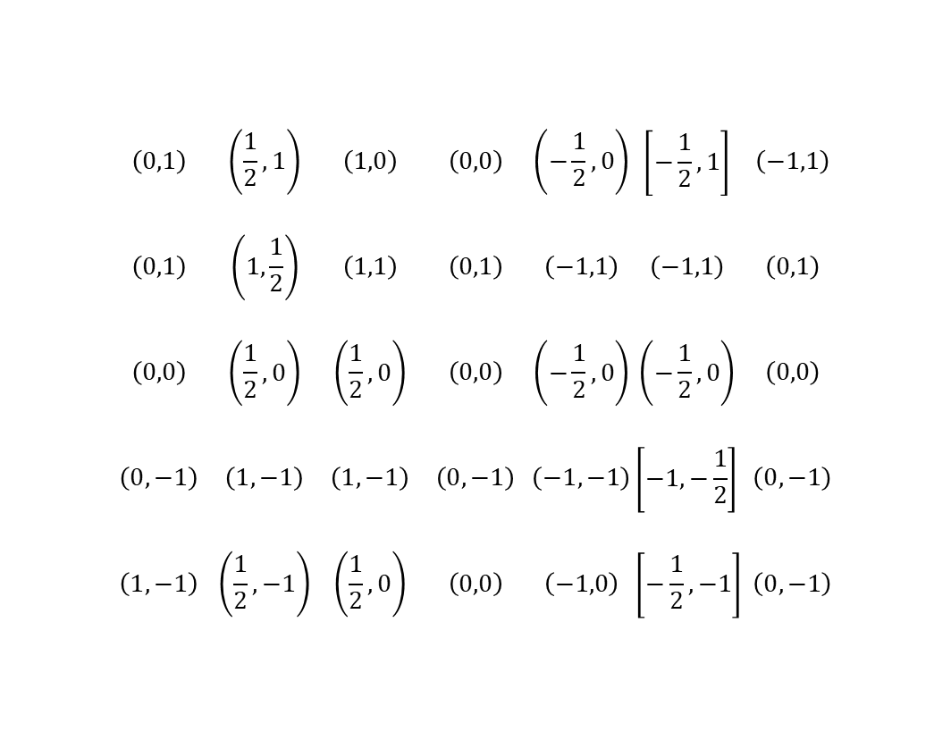
A Toy Example – Gradients
In this discrete toy example, we can calculate gradient at a point $\left(x_{0},y_{0}\right)$ as
$∇f\left(x_{0},y_{0}\right)=\left(\frac{Δf}{Δx},\frac{Δf}{Δy}\right)$ where
$\frac{Δf}{Δx}=\frac{f\left(x_{0}+1,y_{0}\right)−f\left(x_{0}−1,y_{0}\right)}{2}$
$\frac{Δf}{Δy}=\frac{f\left(x_{0},y_{0}+1\right)−f\left(x_{0},y_{0}−1\right)}{2}$
We can visualize these gradients using simple arrows as well
 | $$\left(0,1\right)$$ | $$\left(\frac{1}{2},1\right)$$ | $$\left(1,0\right)$$ | $$\left(0,0\right)$$ | $$\left(−\frac{1}{2},0\right)$$ | $$\left[−\frac{1}{2},1\right]$$ | $$\left(−1,1\right)$$
 | $$\left(0,1\right)$$ | $$\left(1,\frac{1}{2}\right)$$ | $$\left(1,1\right)$$ | $$\left(0,1\right)$$ | $$\left(−1,1\right)$$ | $$\left(−1,1\right)$$ | $$\left(0,1\right)$$
 | $$\left(0,0\right)$$ | $$\left(\frac{1}{2},0\right)$$ | $$\left(\frac{1}{2},0\right)$$ | $$\left(0,0\right)$$ | $$\left(−\frac{1}{2},0\right)$$ | $$\left(−\frac{1}{2},0\right)$$ | $$\left(0,0\right)$$
 | $$\left(0,−1\right)$$ | $$\left(1,−1\right)$$ | $$\left(1,−1\right)$$ | $$\left(0,−1\right)$$ | $$\left(−1,−1\right)$$ | $$\left[−1,−\frac{1}{2}\right]$$ | $$\left(0,−1\right)$$
 | $$\left(1,−1\right)$$ | $$\left(\frac{1}{2},−1\right)$$ | $$\left(\frac{1}{2},0\right)$$ | $$\left(0,0\right)$$ | $$\left(−1,0\right)$$ | $$\left[−\frac{1}{2},−1\right]$$ | $$\left(0,−1\right)$$
Saddle
Local min
0 1 2 3 4 5 6
Local max
0 1 2 3 4 5 6 7 8

Slide 12
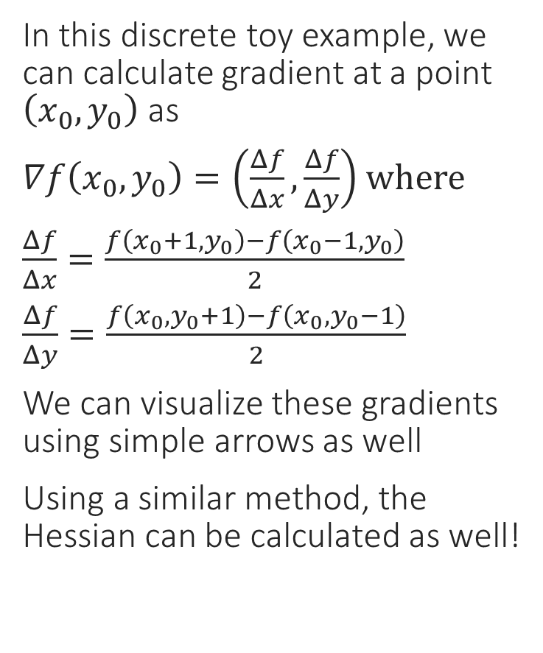
A Toy Example – Gradients
Gradients converge toward local max
In this discrete toy example, we can calculate gradient at a point $\left(x_{0},y_{0}\right)$ as
$∇f\left(x_{0},y_{0}\right)=\left(\frac{Δf}{Δx},\frac{Δf}{Δy}\right)$ where
$\frac{Δf}{Δx}=\frac{f\left(x_{0}+1,y_{0}\right)−f\left(x_{0}−1,y_{0}\right)}{2}$
$\frac{Δf}{Δy}=\frac{f\left(x_{0},y_{0}+1\right)−f\left(x_{0},y_{0}−1\right)}{2}$
We can visualize these gradients using simple arrows as well
Using a similar method, the Hessian can be calculated as well!
Gradients diverge away from local min
0 1 2 3 4 5 6
At saddle points, both can happen along different axes
0 1 2 3 4 5 6 7 8

Slide 13
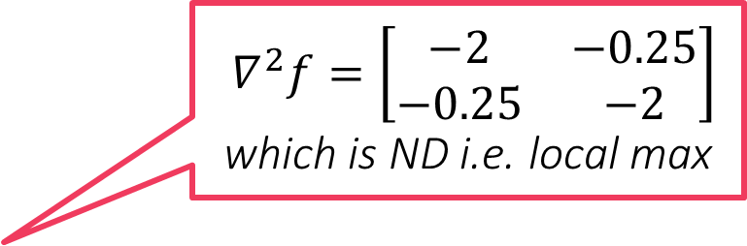
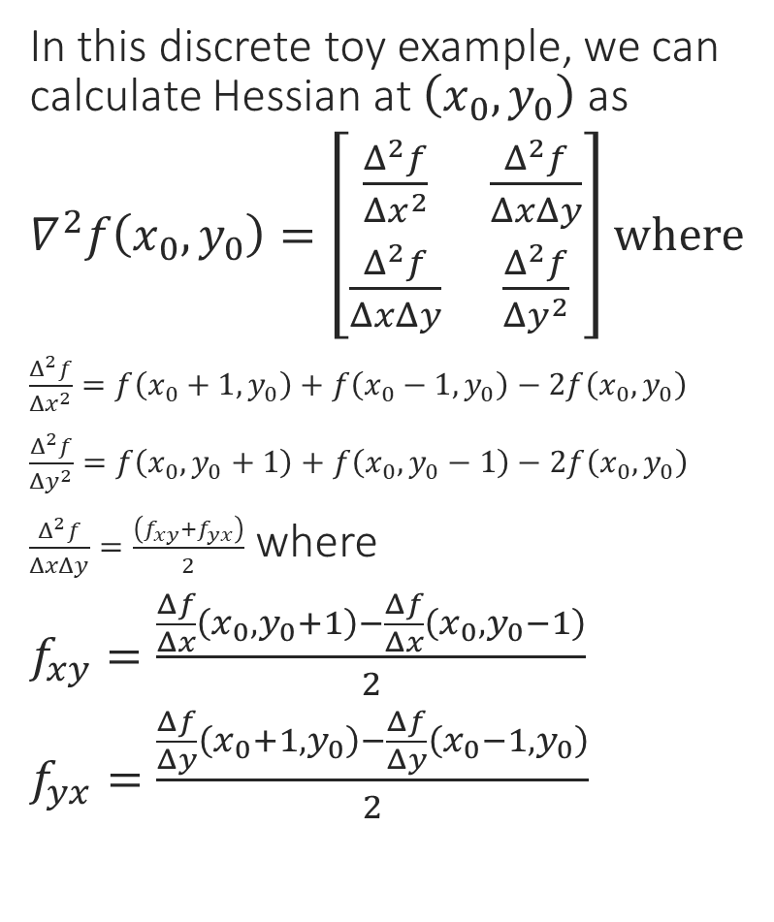
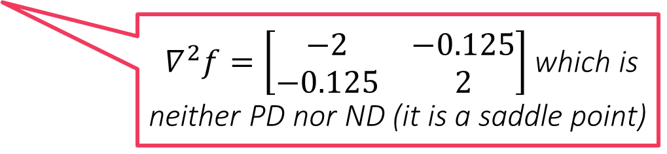

A Toy Example – Hessians
$∇^{2}f=\left[\begin{matrix}−2 & −0.25 \\ −0.25 & −2\end{matrix}\right]$ which is ND i.e. local max
In this discrete toy example, we can calculate Hessian at $\left(x_{0},y_{0}\right)$ as
$∇^{2}f\left(x_{0},y_{0}\right)=\left[\begin{matrix}\frac{Δ^{2}f}{Δx^{2}} & \frac{Δ^{2}f}{ΔxΔy} \\ \frac{Δ^{2}f}{ΔxΔy} & \frac{Δ^{2}f}{Δy^{2}}\end{matrix}\right]$ where
$\frac{Δ^{2}f}{Δx^{2}}=f\left(x_{0}+1,y_{0}\right)+f\left(x_{0}−1,y_{0}\right)−2f\left(x_{0},y_{0}\right)$
$\frac{Δ^{2}f}{Δy^{2}}=f\left(x_{0},y_{0}+1\right)+f\left(x_{0},y_{0}−1\right)−2f\left(x_{0},y_{0}\right)$
$\frac{Δ^{2}f}{ΔxΔy}=\frac{\left(f_{xy}+f_{yx}\right)}{2}$ where
$f_{xy}=\frac{\frac{Δf}{Δx}\left(x_{0},y_{0}+1\right)−\frac{Δf}{Δx}\left(x_{0},y_{0}−1\right)}{2}$
$f_{yx}=\frac{\frac{Δf}{Δy}\left(x_{0}+1,y_{0}\right)−\frac{Δf}{Δy}\left(x_{0}−1,y_{0}\right)}{2}$
$∇^{2}f=\left[\begin{matrix}2 & 0.125 \\ 0.125 & 2\end{matrix}\right]$ which is PD i.e. local min
0 1 2 3 4 5 6
$∇^{2}f=\left[\begin{matrix}−2 & −0.125 \\ −0.125 & 2\end{matrix}\right]$ which is neither PD nor ND (it is a saddle point)
0 1 2 3 4 5 6 7 8

Slide 14


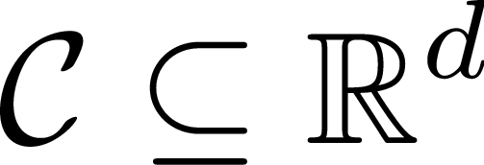

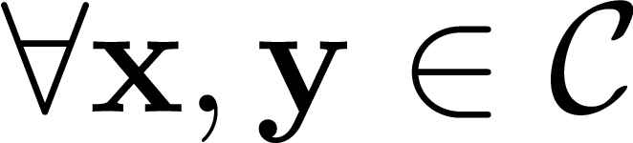
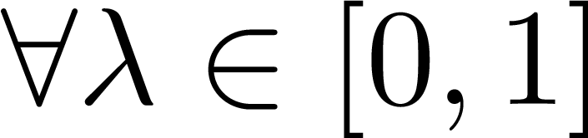
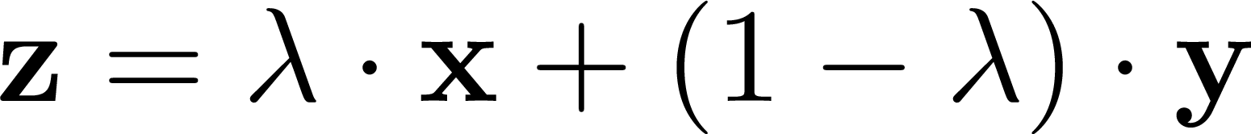

Convex Sets
CONVEX SET
NON-CONVEX SET
Think about which common shapes/objects are convex and which are not – balls, cuboids, stars, rectangles?
The intersection of two convex sets is always convex. The union may or may not be convex!

Slide 15
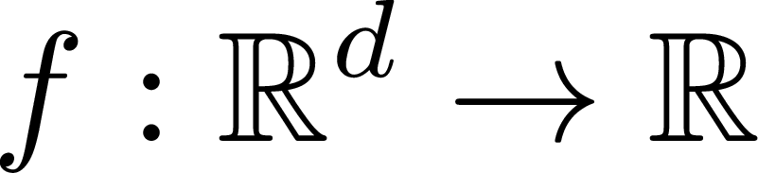




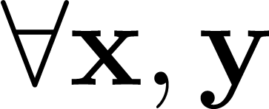
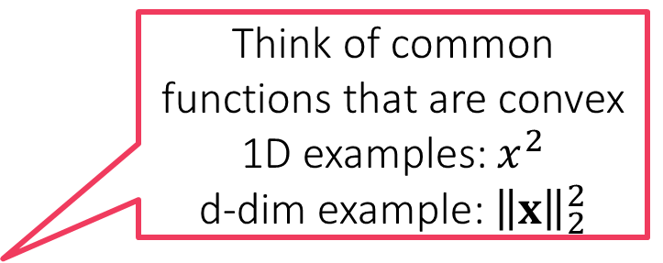
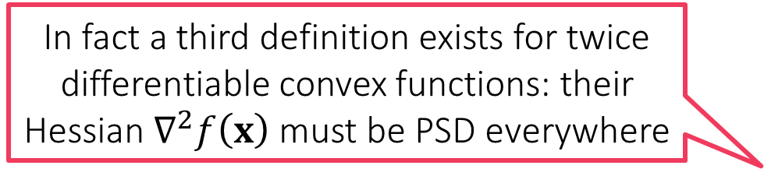
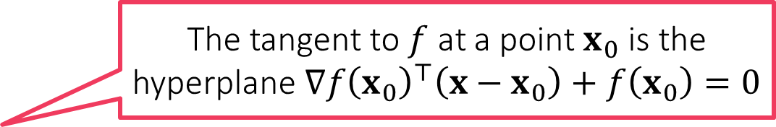
Convex Functions
The tangent to $f$ at a point $x_{0}$ is the hyperplane $∇f{\left(x_{0}\right)}^{⊤}\left(x−x_{0}\right)+f\left(x_{0}\right)=0$
Think of common functions that are convex 1D examples: $x^{2}$
d-dim example: ${\left\|x\right\|}_{2}^{2}$
CONVEX FUNCTION
NON-CONVEX
FUNCTION
A differentiable convex function must lie above all its tangents
For differentiable functions, a nicer definition
The sum of two convex functions is always convex. The difference may or may not be convex
In fact a third definition exists for twice differentiable convex functions: their Hessian $∇^{2}f\left(x\right)$ must be PSD everywhere
A convex function must lie below all its chords

Slide 16
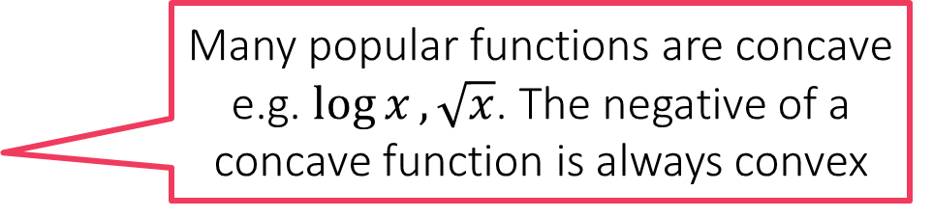

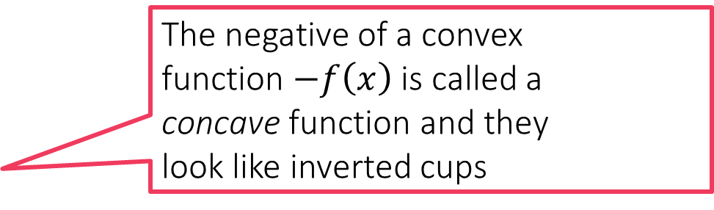
Checking for Convexity
All constant functions $f\left(x\right)=c$ are convex
All linear functions $f\left(x\right)=a^{⊤}x$ are convex
Sums of convex functions are convex
Positive multiples of convex functions $c⋅f\left(x\right), c≥0$ are convex
If $g:ℝ^{d}→ℝ$ is convex and $f:ℝ→ℝ$ is convex and non-decreasing i.e. $a≥b⇒f\left(a\right)≥f\left(b\right)$, then $f∘g:ℝ^{d}→ℝ$ is convex
The Euclidean distance is convex $f\left(x\right)={\left\|x\right\|}_{2}$ is convex
If $f:ℝ→ℝ$ is convex then $g\left(x\right)=f\left(a^{⊤}x+b\right)$ is also convex
Many popular functions are concave e.g. $\log{x}, \sqrt{x}$. The negative of a concave function is always convex
The negative of a convex function $−f\left(x\right)$ is called a concave function and they look like inverted cups
I also love concave functions since all local maxima are global maxima for a concave function
Convex functions look like cups
I love convex functions since all local minima are global minima for a convex function

Slide 17

Non-differentiable Functions
The hinge loss function is not differentiable everywhere ☹
Can we define some form of gradient for non-diff functions as well?
Yes, if a function is convex, then no matter if it is non-differentiable, a notion of gradient called subgradient can always be defined for it
Recall that for differentiable functions, the gradient defines a tangent hyperplane at every point and the function must lie above this plane
Subgradients exploit and generalize this property ☺
Point of non-differentiability

Slide 18


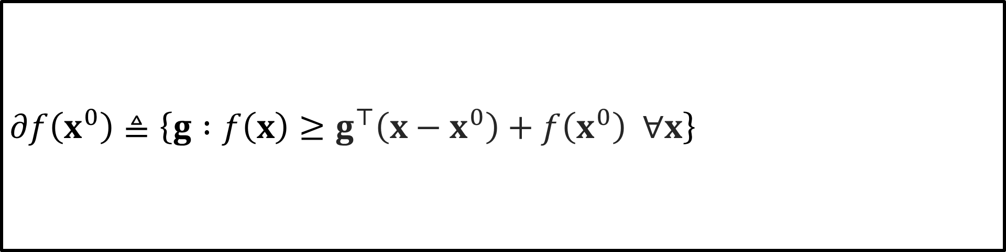
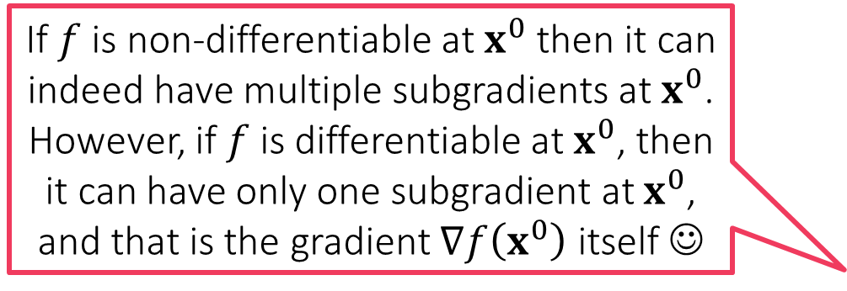
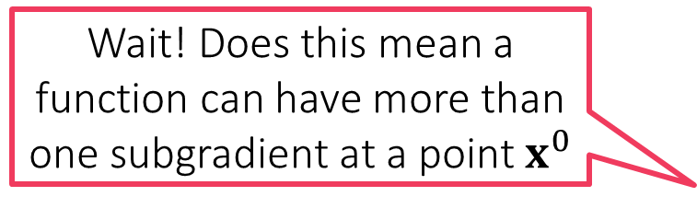
Subgradients and the subdifferential
How can I find out the subgradients of a function?
Wait! Does this mean a function can have more than one subgradient at a point $x^{0}$
Tangents of a convex differentiable function $f:ℝ^{d}→ℝ$ are uniquely linked to its gradients
The tangent at $x^{0}$ is the hyperplane $∇f{\left(x^{0}\right)}^{⊤}\left(x−x^{0}\right)+f\left(x^{0}\right)$
Convex functions lie above all tangents $f\left(x\right)≥∇f{\left(x^{0}\right)}^{⊤}\left(x−x^{0}\right)+f\left(x^{0}\right)$
Trick: turn the definition around and say that gradient at $x^{0}$ is a vector $g$ so that the hyperplane $g^{⊤}\left(x−x^{0}\right)+f\left(x^{0}\right)=0$ is tangent to $f$ at $x^{0}$
Subgradients: given a (possibly non-differentiable but convex) function $f:ℝ^{d}→ℝ$ and a point $x^{0}$, any vector $g$ that satisfies $f\left(x\right)≥g^{⊤}\left(x−x^{0}\right)+f\left(x^{0}\right)$ is called a subgradient of $f$ at $x^{0}$
Subdifferential: the set of all subgradients of $f$ at a point $x^{0}$ is known as the subdifferential of $f$ at $x^{0}$ and denoted by $∂f\left(x^{0}\right)$
If $f$ is non-differentiable at $x^{0}$ then it can indeed have multiple subgradients at $x^{0}$. However, if $f$ is differentiable at $x^{0}$, then it can have only one subgradient at $x^{0}$, and that is the gradient $∇f\left(x^{0}\right)$ itself ☺
$$∂f\left(x^{0}\right)≜\left\{g :f\left(x\right)≥g^{⊤}\left(x−x^{0}\right)+f\left(x^{0}\right) ∀x\right\}$$

Slide 19

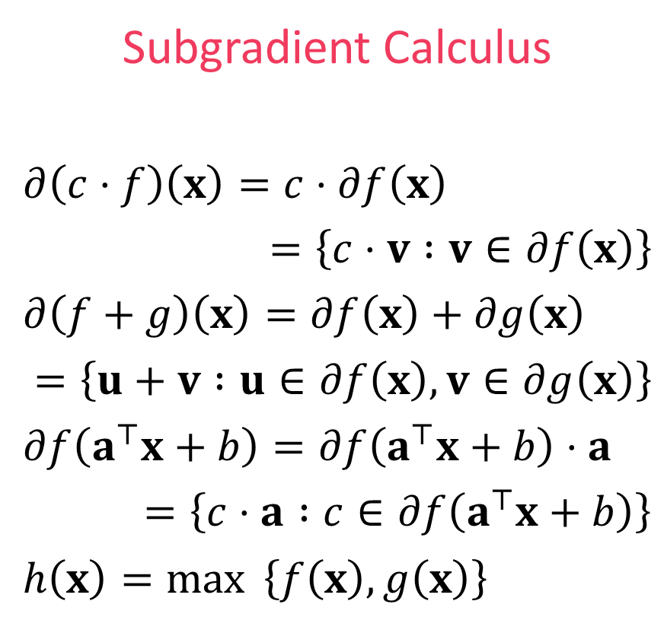

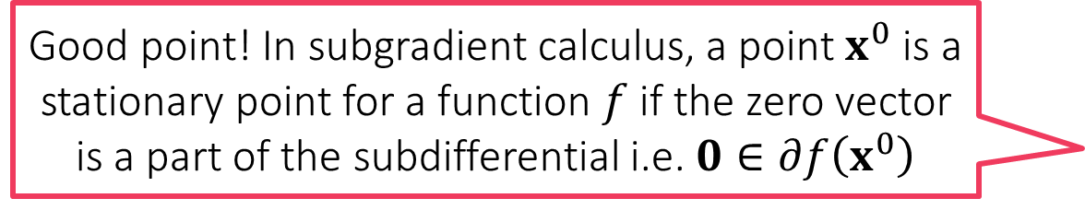

Subgradient Calculus
What about stationary points?
Good point! In subgradient calculus, a point $x^{0}$ is a stationary point for a function $f$ if the zero vector is a part of the subdifferential i.e. $0∈∂f\left(x^{0}\right)$
Gradient Calculus
$∇\left(c⋅f\right)\left(x\right)=c⋅∇f\left(x\right)$
$∇\left(f+g\right)\left(x\right)=∇f\left(x\right)+∇g\left(x\right)$
$∇f\left(a^{⊤}x+b\right)=f^{′}\left(a^{⊤}x+b\right)⋅a$
No counterpart in general
Subgradient Calculus
$∂\left(c⋅f\right)\left(x\right)=c⋅∂f\left(x\right)$
$=\left\{c⋅v :v∈∂f\left(x\right)\right\}$
$∂\left(f+g\right)\left(x\right)=∂f\left(x\right)+∂g\left(x\right)$
$=\left\{u+v :u∈∂f\left(x\right),v∈∂g\left(x\right)\right\}$
$∂f\left(a^{⊤}x+b\right)=∂f\left(a^{⊤}x+b\right)⋅a$
$=\left\{c⋅a :c∈∂f\left(a^{⊤}x+b\right)\right\}$
$h\left(x\right)=\max{ \left\{f\left(x\right),g\left(x\right)\right\}}$
Scaling Rule
Sum Rule
Chain Rule
Max Rule
$$x∈ℝ^{d},a∈ℝ^{d},b,c∈ℝ$$
Local minima/maxima must be stationary in this sense even for non-differentiable functions
If $f\left(x^{0}\right)>g\left(x^{0}\right),∂h\left(x^{0}\right)=∂f\left(x^{0}\right)$. If $g\left(x^{0}\right)>f\left(x^{0}\right),∂h\left(x^{0}\right)=∂g\left(x^{0}\right)$
If $f\left(x^{0}\right)=g\left(x^{0}\right), ∂h\left(x^{0}\right)=\{λu+\left(1−λ\right)v :u∈∂f\left(x^{0}\right),v∈∂g\left(x^{0}\right),λ∈\left[0,1\right]\}$

Slide 20
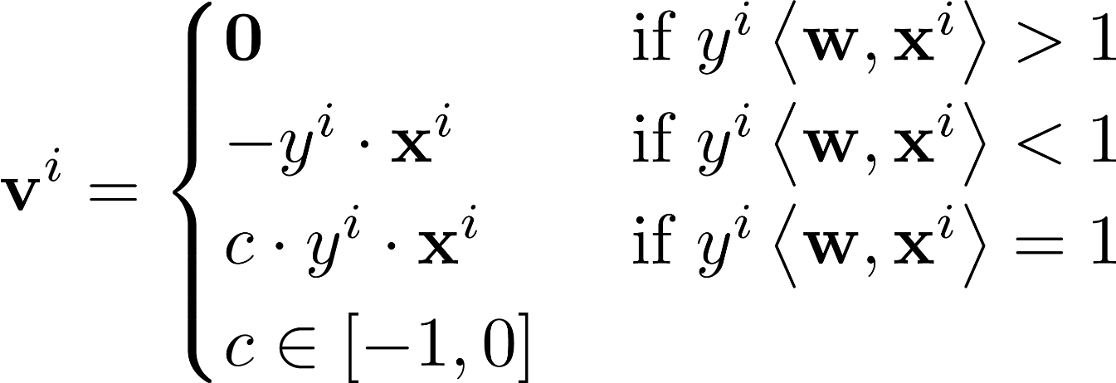

Example: subgradient for hinge loss
$ℓ_{hinge}\left(x\right)=\max\left\{1−x,0\right\}=\max{ \left\{f\left(x\right),g\left(x\right)\right\}}$
$ℓ_{hinge}$ is differentiable at all points except $x=1$
Thus, $∂ℓ_{hinge}\left(x\right)=ℓ_{hinge}^{′}\left(x\right)$ if $x≠1$
At $x=1$ use subdifferential calculus
$f\left(x\right)=1−x$ (differentiable) i.e. $∂f\left(x\right)=f^{′}\left(x\right)=−1$
$g\left(x\right)=0$ (differentiable) i.e. $∂g\left(x\right)=g^{′}\left(x\right)=0$
Thus, $∂ℓ_{hinge}\left(1\right)=\left\{λ⋅\left(−1\right)+\left(1−λ\right)⋅0 :λ∈\left[0,1\right]\right\}=\left[−1,0\right]$
Applying subgradient chain rule gives us

